Slide 1
ENHANCEMENT OF SOIL PROPERTIES USING BANANA PEEL BIO POWDER AS A STABILIZER

Slide 2
AIM
To analysis the properties of soil before and after the treatment by adding the banana peel bio powder.

Slide 3
ABSTRACT
The Effect of Banana Peel Bio powder on the strength properties of the soil had studied. This soil is said to be an extensive soil and mostly exposed to volumetric changes in moisture because of the influence of mineral present in it . Various materials has been used in the past to stabilize the soil but in this study an attempt is made by stabilizing with banana peel powder . The soil is obtained from OMR , Chennai . Engineering properties of the soil is to be determined using banana peel powder by several laboratory experiments like Standard proctor test, unconfined compressive strength and California bearing ratio.

Slide 4
OBJECTIVE
To study the Properties of the soil.
To study the properties of the stabilized soil using banana Peel bio powder.
To find out the optimum content of banana peel Bio powder to be added for obtaining maximum strength.

Slide 5
LITERATURE REVIEW
AUTHORS | TITLE | YEAR | INFERENCE
Ishola, K., 1Olawuyi, O.A., 1Bello, A.A. and 2Yohanna, P. | Effect of Plantain Peel Ash on the Strength Properties of Tropical Red Soil | 2019 | The possibility of using agricultural wastes such as saw dust ash, plantain peel ash, rice husk ash , bagasse ash etc. Because their pozzolanic nature in treatment of deficient soils have recorded positive results.The improvement of lateritic soil with plantain peel ash having pozzolanic property may be relatively cheaper. PPA treated lateritic soil at 4% PPA content can be used as subgrade material in admixture stabilization with a more potent industrially made stabilizer in order to lessen cost of road construction.
Akinwande J.T | Engineering Properties of Black Cotton Soil Stabilized with Plantain Peel Powder | 2018 | Soil is Stabilizing with plantain peel powder (PPP). To determine the Engineering properties of the BCS when stabilized with PPP, several laboratory tests, such as Grain Size Analysis, Natural Moisture Content, Linear Shrinkage, Specific gravity, Atterberg's limit which were all carried out in line with the British Standard code of practice. Plantain Peel Powder (PPP) is suitable for stabilizing material for roadworks.

Slide 6
AUTHORS | TITLE | YEAR | INFERENCE
Emeka Segun Nnochiri and Olufikayo .O. Aderinlewo | Geotechnical Properties of Lateritic Soil Stabilized with Banana Leaves Ash | 2016 | This paper investigated the geotechnical properties of lateritic soil stabilized with banana leaves ash. When the banana leaves ashes were added to the soil at varying proportions of 2, 4, 6, 8 and 10% by weight of soil.. The unsoaked CBR value of the soil at its natural state was 10.42 % and it got to optimum value of 28.10% by addition of 4% banana leaves ash by weight of soil. The unconfined compressive strength improved from 209.1 kN/m2 at natural state to 233.77 kN/m2 at 4% banana leaves ashes.
K. Ishola1 , O. A. Olawuyi1 , P. Yohanna2 , A. A. Bello1 , R.O. Sani3 , O. O. Akin4 | Reliability Evaluation of Compaction Water Content of Plantain Peel Ash Treated Lateritic Soil | 2018 | The results revealed that the safety index is sensitive to changeability in the soil factors . It is essential to control Gs and CE in lateritic soil–PPA mixes in road pavements. From the safety index values it reveals that PPA content has a minimal consequence as its value virtually remained constant at all COV used. Therefore a more effective additive such as cement, lime, or bitumen is recommended for modeling CWC of lateritic soil-PPA mixes for road pavement at 10–100% series of COV.

Slide 7
Literature review
Collection of soil sample
Determination of soil properties and banana peel bio powder
Strength analysis on banana peel bio powder mixed soil
Result and Conclusion
METHODOLOGY

Slide 8
MATERIALS
The Banana peel bio powder had been ordered and shipped from APKA industries , Karur , Tamil Nadu
The fresh banana peel bio powder were cut and dried in the sun to facilitate easy burning.
The dried banana peel were burnt to ashes and were thereafter collected in polythene bags, to ensure that the ash is prevented from moisture and contaminations from other materials and stored under room temperature until it was used.
Furthermore, the ashes from the burnt leaves were sieved through IS-450 micron to get the very fine ash.
The disturbed soil samples were collected within the campus of the St.Joseph’s College of Engineering ,OMR , Chennai

Slide 9
BANANA PEEL BIO POWDER PROPERTIES
CHEMICAL REPORT | SPECIFICATION
Moisture content | 4% - 9%
Color | Dark Grey Color
Particle size | <=450 micron
Consistency | Free flowing powder
Fiber | 27% - 35%
Taste and pungency | Sour
Carbohydrates | 30% - 40%

Slide 10
LABORATORY EXPERIMENTS
Specific gravity test
Sieve analysis
Atterberg's limits
Standard Proctor Compaction test
Unconfined compression test (UCC)
California bearing ratio (CBR) test
The preliminary tests such as the particle size distribution test, Atterberg limit test and specific gravity tests as well as engineering tests such as; Compaction test, Unconfined Compressive Strength tests and California Bearing Ratio test were carried out on the unstabilized natural soil samples.
Also, engineering tests such as Compaction (Maximum Dry Density and Optimum Moisture Content), Unconfined compressive strength tests and the California Bearing Ratio tests were carried out on the stabilized samples, using the banana bio peel powder ,at varying proportions of 2, 4, 6, 8 % by weight of the soil.

Slide 11
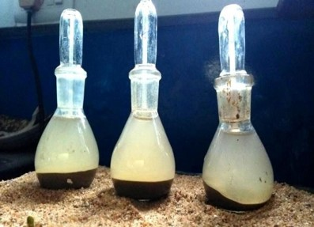
SPECIFIC GRAVITY
ITEM | TRIAL
Weight of pycnometer | 31
Weight of pycnometer +dry soil | 41
Weight of pycnometer +dry soil+ water | 86
Weight of pycnometer + water | 8
Mass of soil solids | 1
Mass of water displaced | 4
SPECIFIC GRAVITY (RATIO ) | 2.5
Specific gravity is the ratio of the density of a substance to the density of reference substance at a fixed temperature .

Slide 12
SIEVE ANALYSIS
IS SIEVE DESIGNATION | EMPTY WEIGHT OF SIEVE (W₁) (G) | WEIGHT OF SIEVE AND SOIL (W₂) (G) | WEIGHT OF SOIL RETAINED IN (W_{D}= W₂-W₁) (G) | SOIL RETAINED AS PERCENTAGE OF PARTICULAR SOIL TAKEN N₁ = W_{D}/W_{C})*100 | PERCENTAGE FINER N (%)
4.75 mm | 318 | 291 | 153 | 7.7272 | 92.2728
2.36mm | 202 | 217 | 15 | 0.7575 | 91.5153
1.18mm | 303 | 655 | 352 | 17.777 | 73.7453
0.71 mm | 248 | 311 | 63 | 3.18181 | 70.56349
0.425 mm | 337 | 518 | 181 | 9.14141 | 61.42208
0.212 mm | 327 | 480 | 153 | 7.7272 | 53.69488
0.125 mm | 221 | 267 | 46 | 2.3232 | 51.37168
0.075 mm | 264 | 296 | 32 | 1.61616 | 49.755552
Pan | 232 | 237 | 5 | 0.252 | 49.50352

Slide 13
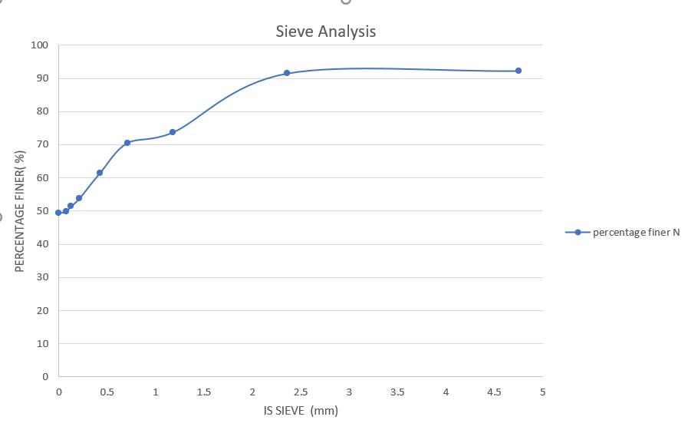
Graph for sieve analysis
A Graph determines that the Grain Size distribution of soils that are greater than 0.075mm in diameter

Slide 14
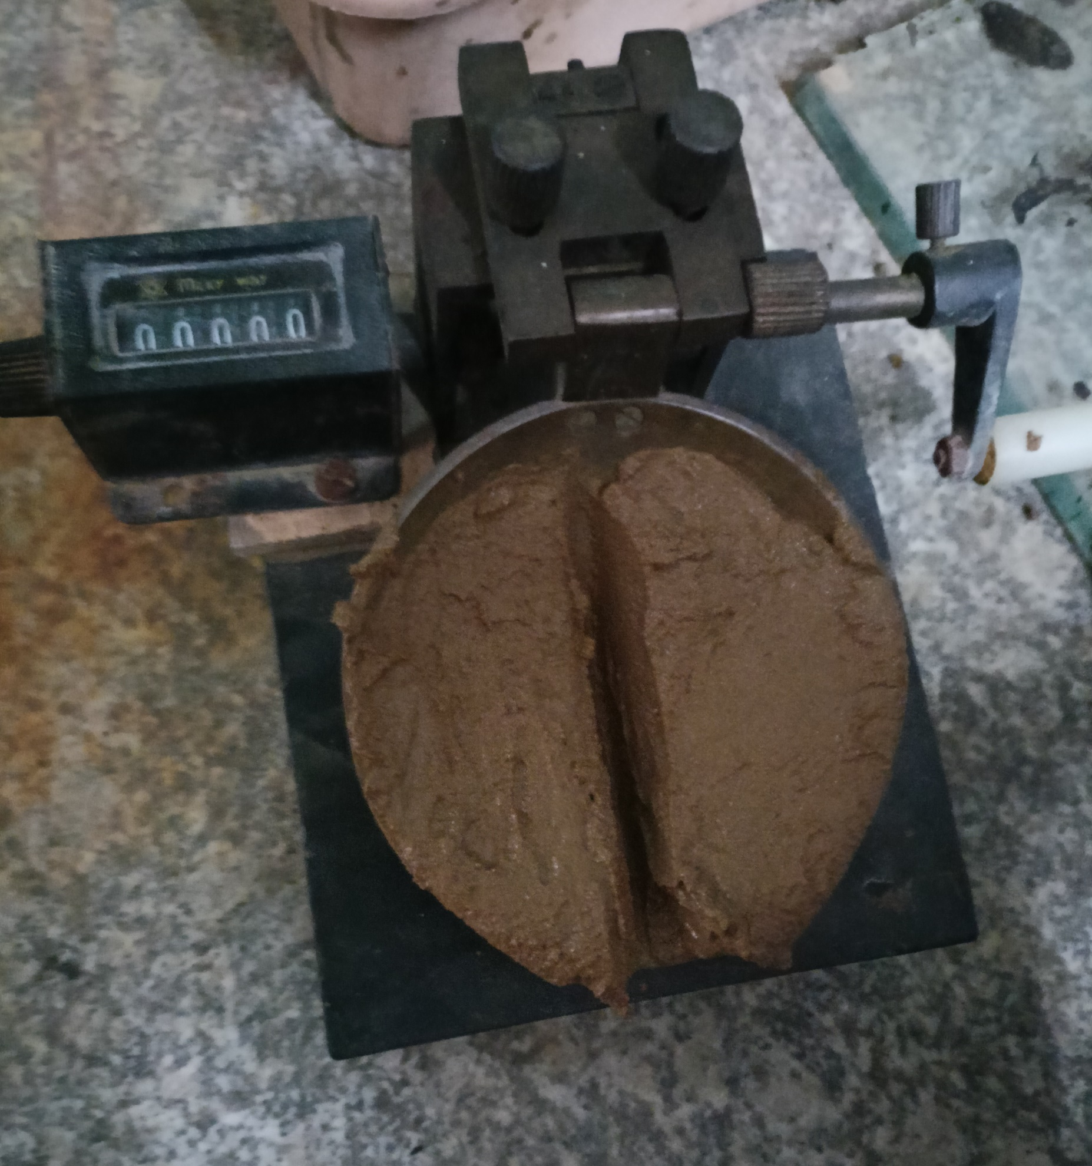
LIQUID LIMIT
Water content percentage (%) | No of blows (n)
12.5% | 69
15% | 43
20% | 31
25% | 19
30% | 12
LIQUID LIMIT APPARATUS

Slide 15
Liquid limit graph
This graph is used to predict the consolidation properties of soil while calculating allowable bearing capacity and settlement of foundation
Water content at 15 blows = 27%

Slide 16
PLASTIC LIMIT OF SOIL
TRIAL NO / TARE NO | 1 | 2 | 3 | 4 | 5 | 6
Weight of tare (g) (A) | 11 | 11 | 11 | 11 | 11 | 11
Weight of wet sample + tare (g) (B) | 14 | 15 | 16 | 14 | 15 | 13
Weight of dry sample + tare (g) (C) | 14 | 14 | 13 | 14 | 14 | 12
Weight of water (D=B-C) (g) | 0 | 1 | 3 | 0 | 1 | 1
Weight of dry soil (E=C-A) (g) | 3 | 3 | 2 | 3 | 3 | 1
Water content w (D/E)*100 (%) | 0 | 33.3 | 150 | 0 | 33.3 | 100
Plastic limit of the soil = 52.766 (%)

Slide 17
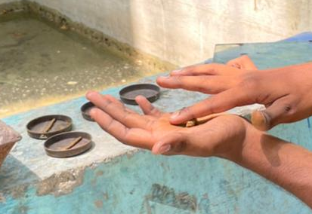
PLASTIC LIMIT OF SOIL
The plastic limit of a soil is the moisture content at which soil begins to behave as a plastic material .
At this water content ,the soil will crumble when rolled into threads of 3.2mm in diameter

Slide 18
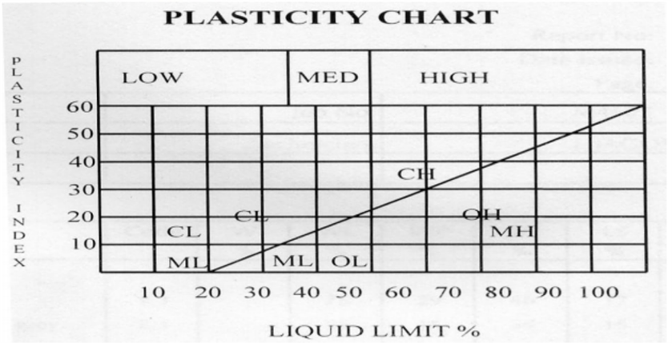
A-line graph
PLASTICITY INDEX=59.80%
As per IS Plasticity chart as LL is between 35%-50% & PL>50%. Hence soil is found to be CL-soil

Slide 19
STANDARD PROCTOR COMPACTION TEST RESULT
WATER CONTENT (%) | SOIL WEIGHT
5% | 1.022
7.5% | 1.4493
10% | 1.4545
12.5% | 1.37875
15% | 1.30711
In the compaction test it is very clear that as the percentage of powdered BPP increases the dry density.
This is mainly because of the light weight property of BPP.
Thus the max dry density of stabilized soil is 1.4545g/cc & optimum moisture content is 10%

Slide 20
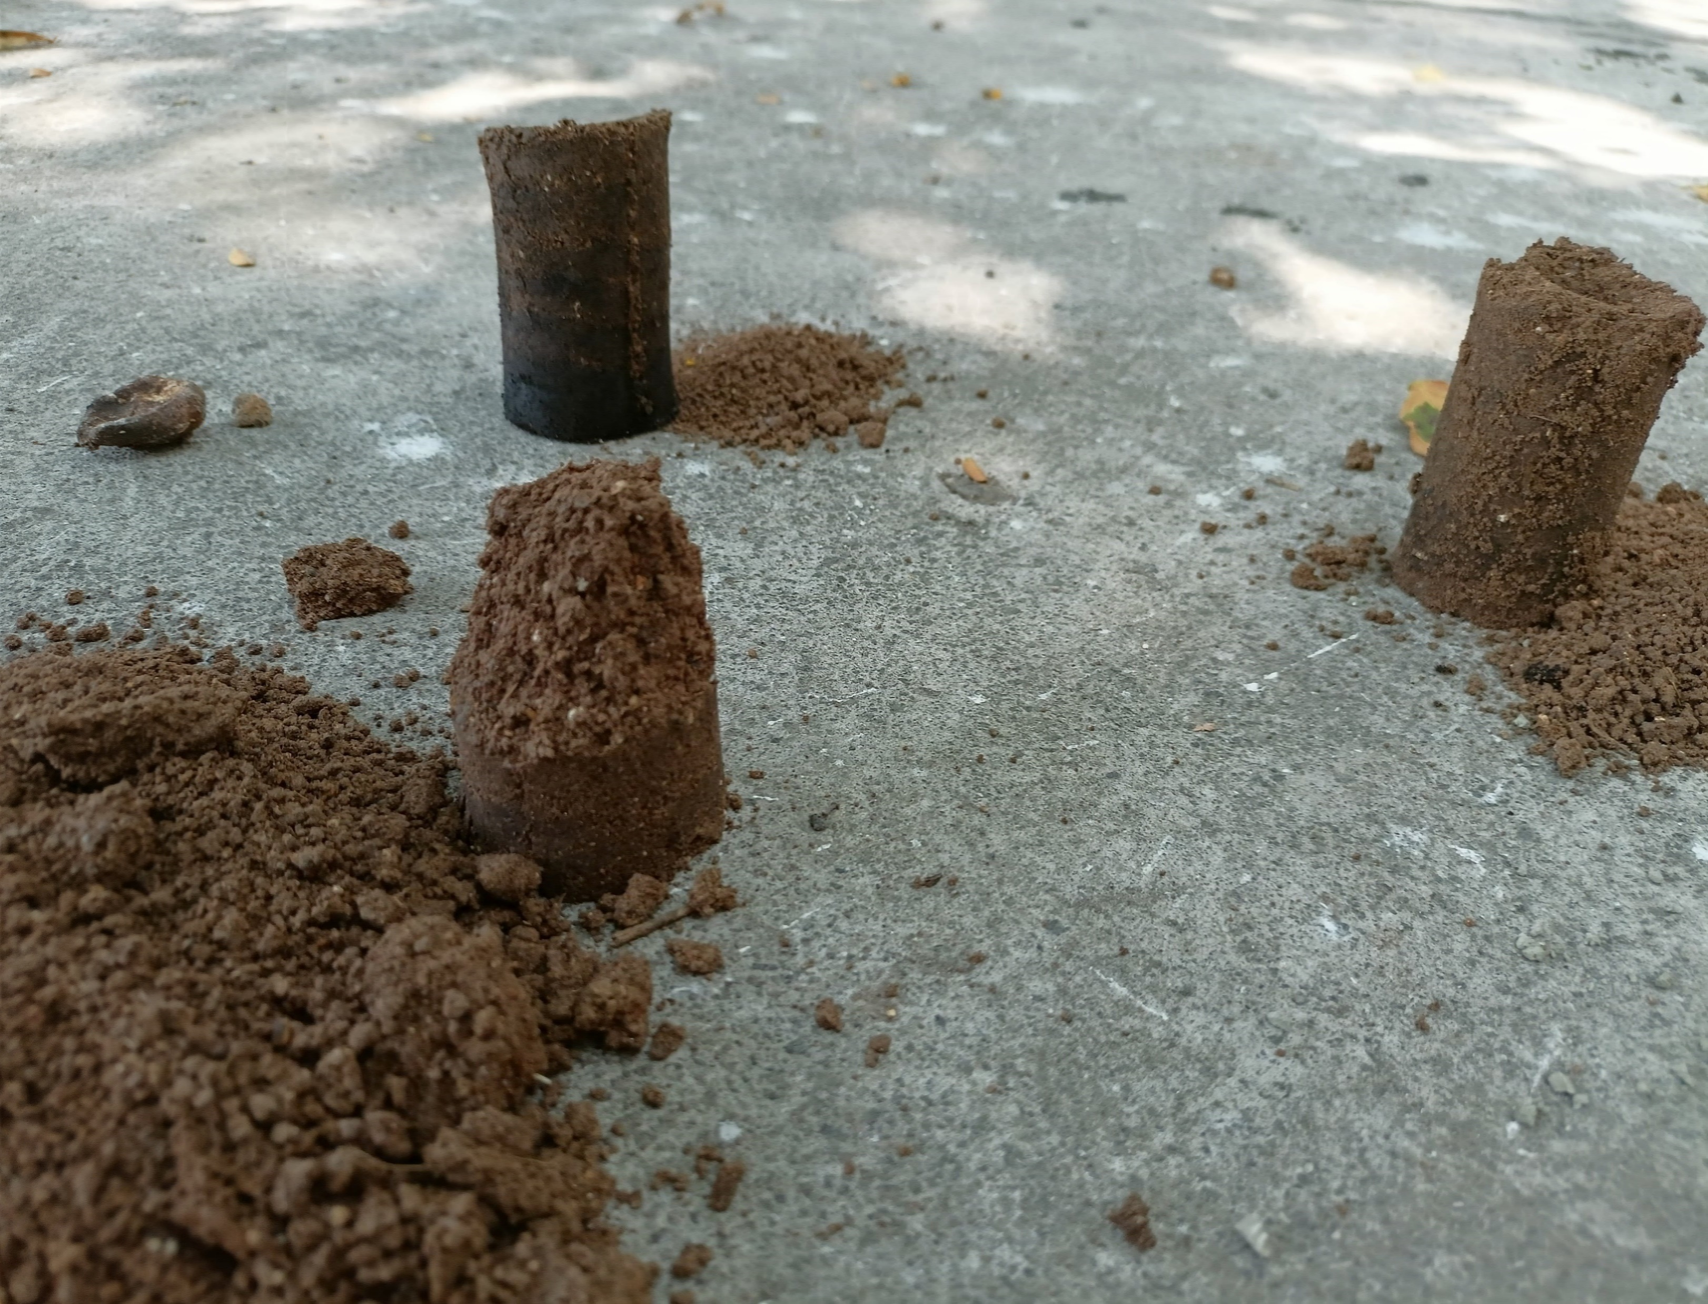
FLOW CURVE FOR STANDARD PROCTOR COMPACTION TEST

Slide 21
CALIFORNIA BEARING RATIO TEST
Penetration in mm | LOAD in kgf
0 | 0
0.2 | 218
0.4 | 309
0.6 | 362
0.8 | 406
1 | 447
1.2 | 470
1.4 | 489
1.6 | 511
1.8 | 545
2 | 573
2.2 | 617
2.3 | 624
This measures the strength of the subgrade of a road other paved area and of materials used in construction.

Slide 22
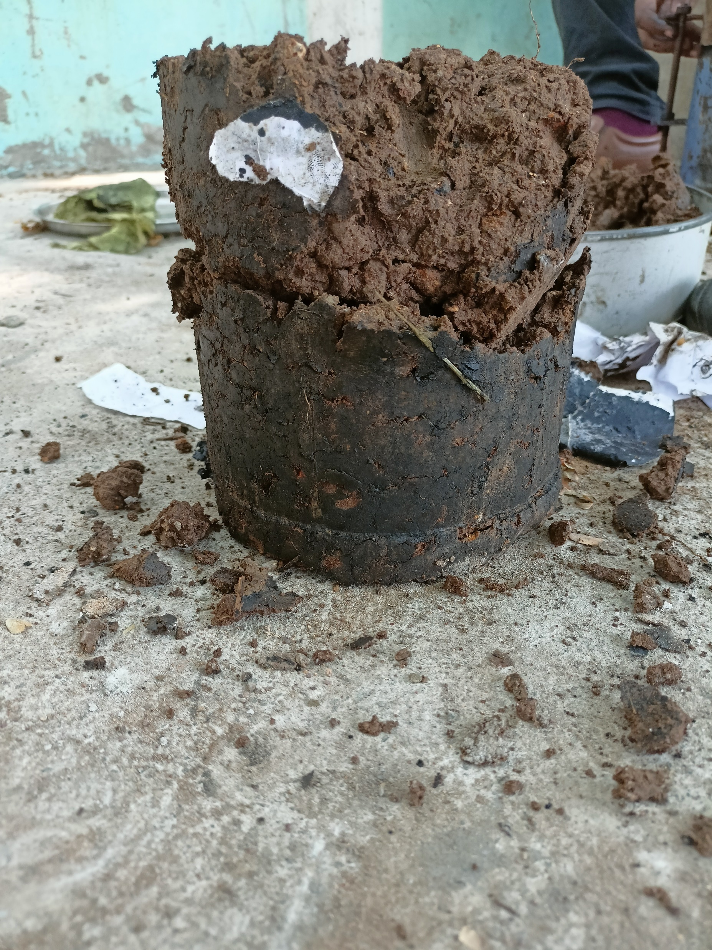

Slide 23
STRAIN | STRESS
0.001467 | 0.00312
0.002893 | 0.00623
0.003627 | 0.009339
0.004173 | 0.012445
0.004867 | 0.015545
0.005693 | 0.018639
0.006133 | 0.021735
0.006427 | 0.024833
0.007 | 0.027921
0.007333 | 0.031013
0.008093 | 0.034088
0.008413 | 0.037175
0.008933 | 0.040252
0.009653 | 0.043317
0.01116 | 0.04634
0.01172 | 0.049401
0.011987 | 0.052475
0.012253 | 0.055547
0.012547 | 0.058615
0.012893 | 0.061678
0.013307 | 0.064735
0.01376 | 0.067787
0.01428 | 0.070831
0.014893 | 0.073864
0.015733 | 0.076876
0.016213 | 0.079912
0.01664 | 0.073733
STRAIN | STRESS
0.007493 | 0.003101
0.008227 | 0.006197
0.00912 | 0.009287
0.009987 | 0.012372
0.010787 | 0.015453
0.01164 | 0.018527
0.012587 | 0.021594
0.012907 | 0.024671
0.01388 | 0.027743
0.014653 | 0.030784
0.015253 | 0.033842
0.01568 | 0.036903
0.016373 | 0.03995
0.016427 | 0.04302
0.017253 | 0.039914
0.017533 | 0.033764
STRAIN | STRESS
0.006253 | 0.003105
0.007693 | 0.0062
0.00856 | 0.009292
0.0106 | 0.012364
0.010693 | 0.015454
0.010893 | 0.018541
0.011187 | 0.021625
0.012093 | 0.024691
0.013507 | 0.027738
0.014693 | 0.030783
0.015387 | 0.024609
UNCONFINED COMPRESSION TEST
STRESS STRAIN VALUE OF SOIL+4%OF BPP
STRESS STRAIN VALUE OF VIRGIN SOIL
STRESS STRAIN VALUE OF SOIL+2%OF BPP

Slide 24
STRAIN | STRESS
0.007293 | 0.003101
0.00828 | 0.006197
0.008533 | 0.009293
0.009853 | 0.012374
0.011227 | 0.015446
0.011987 | 0.018521
0.012093 | 0.021605
0.01352 | 0.024656
0.014467 | 0.018474
STRAIN | STRESS
0.008093 | 0.003099
0.011053 | 0.006179
0.012227 | 0.009258
0.014373 | 0.012317
0.014547 | 0.009236
STRESS STRAIN VALUE OF SOIL+8%OF BPP
STRESS STRAIN VALUE OF SOIL+6%OF BPP

Slide 25
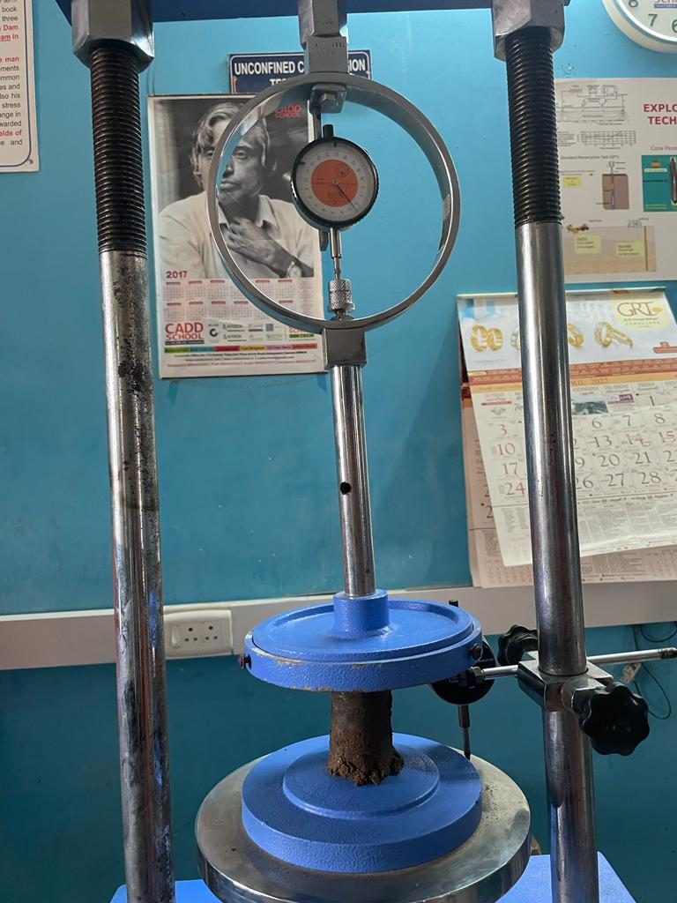
UNCONFINED COMPRESSION TEST
Soil sample | UCS Value(Kg/cm2)
Virgin soil | 0.079
Soil+ 2% BMC | 0.043
Soil+ 4% BMC | 0.030783
Soil+ 6% BMC | 0.024656
Soil+ 8% BMC | 0.012317

Slide 26
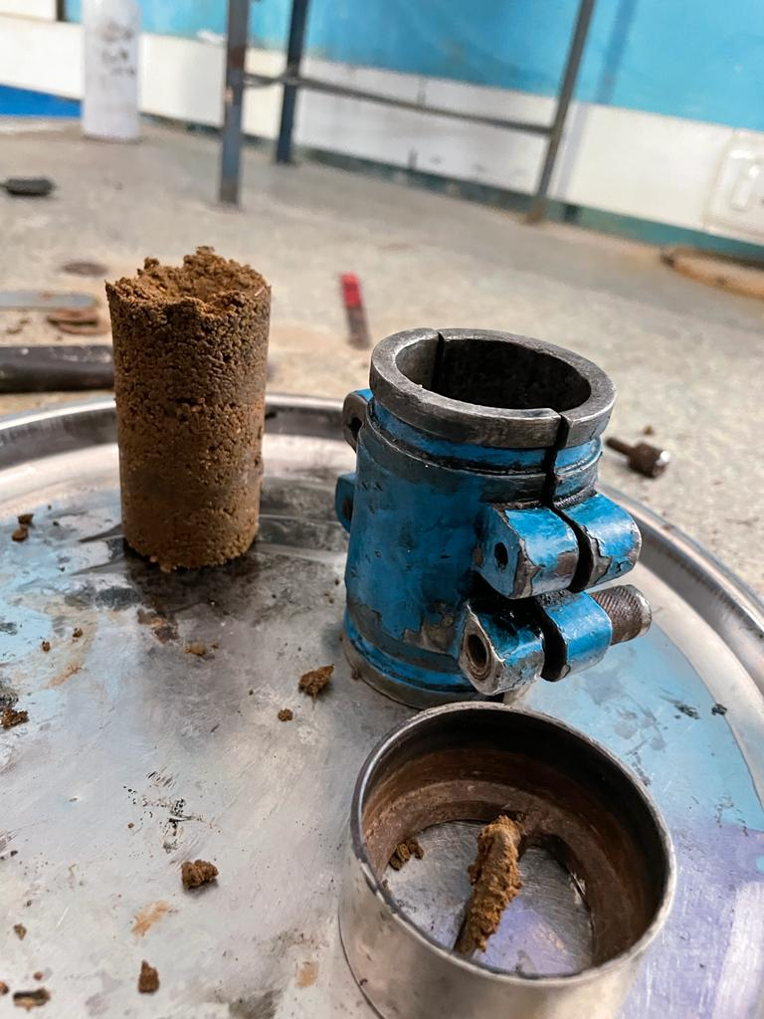
The UCC value increases with in BPP content to 2%and it continues decreases.
Thus the unconfined strength of the stabilized clay soil is 0.07991kg/cm²

Slide 27
CONCLUSION
This analysis of the geotechnical properties of soil using ash of banana peel bio powder as stabilizers as the basis for comparison has been carried out .
The study has revealed that banana peel bio powder satisfactorily act as cheap stabilizing agents for subgrade purposes.
Optimum CBR results can be achieved by adding 6 % banana peel bio powder by weight of soil to the natural soil sample.
The UCC value in BPP content at 2%, and then decreases gradually.

Slide 28
REFERENCE
Shiva Prasad.A, P.T.Ravichandran, R.Annadurai, P.R.Kannan Rajkumar “Study on Effect of Crumb Rubber on Behavior of Soil”. International Journal Of Geomatics And Geosciences Volume 4, No 3, 2014.
B.R.K. Sai Ganesh Kumar, R.V.L. Sai Sumedha, U. Pradeep, K. Gowtham Kumar, P. Padmanabha Reddy “ Subgrade Strengthening Of Roads On Black Cotton Soil Using Quarry Dust”. International Journal of Research in Engineering and Technology eISSN: 2319-1163 | pISSN: 2321-7308
Mohamed A. Shahin and Liao S. Hong “Utilization of Shredded Rubber Tires for Cement-Stabilized Soft Clays”.
Shiva Prasad.A, P.T.Ravichandran, R.Annadurai, P.R.Kannan Rajkumar “ Study on Effect of Crumb Rubber on Behavior of Soil” International Journal of Geomatics and Geosciences Volume 4, No 3, 2014.
Ghatge Sandeep Hambirao,Dr.P.G.Rakaraddi “Soil Stabilization Using Waste Shredded Rubber Tyre Chips”. IOSR Journal of Mechanical and Civil Engineering (IOSR-JMCE) e-ISSN: 2278-1684,p-ISSN: 2320-334X, Volume 11, Issue 1 Ver. V (Feb. 2014)
Kavish S. Mehta, Rutvij J. Sonecha, Parth D. Daxini, Parth B. Ratanpara, Miss Kapilani S. Gaikwad “Analysis of Engineering Properties of Black Cotton Soil & Stabilization Using By Lime.” Miss K S. Gaikwad et al Int. Journal of Engineering Research and Applications,ISSN : 2248-9622, Vol. 4, Issue 5( Version 3), May 2014.

Slide 29
THANK YOU

